Slide 1
AIR FORCE SCHOOL WESTERN AIR COMMAND
E-CONTENT
ENGLISH
PREPARED BY AFS HQ WAC(U)

Slide 14
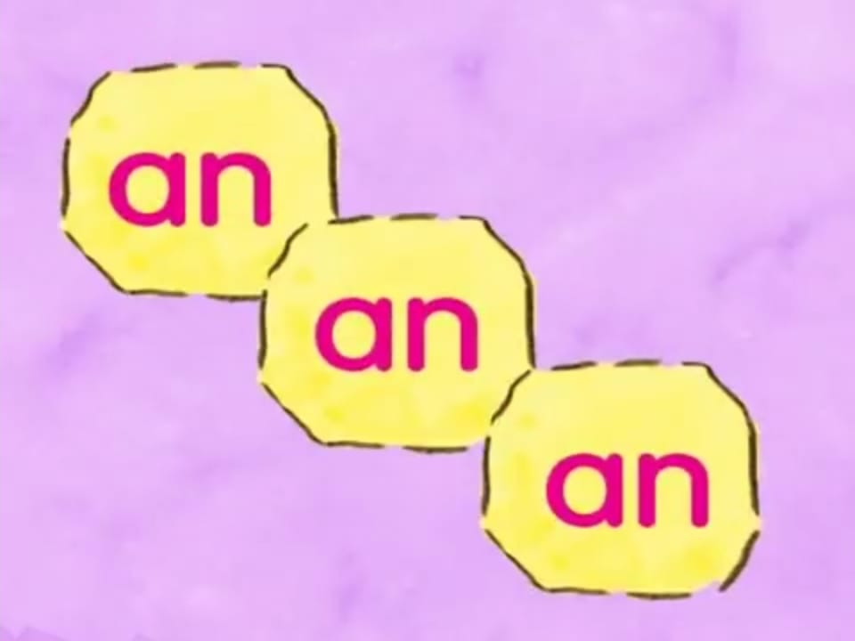

Slide 19
